Slide 1


Zomato Data Analysis
Rakshita Thawkar
© All rights reserved by Fireblaze Technologies Pvt. Ltd.

Slide 2
Problem Statement
Analysing Zomato dataset to study about the different restaurants at different locations in the world.
As Zomato is a start-up from India, it has maximum business spread across Indian restaurants.
In pre-processing we will gain several insights about the restaurants in the dataset, e.g., restaurant’s major locational spread, their ratings, their Cuisines…etc.
Some specific questions to answer using Exploratory Data Analysis and Visualisations:
What kind of food is most popular in a locality?
Localities with major number of restaurants?
© All rights reserved by Fireblaze Technologies Pvt. Ltd.

Slide 3
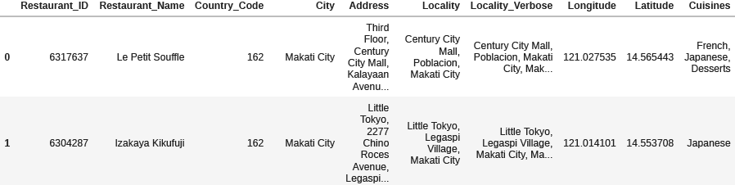
Data Pre-Processing
Renamed Columns. (For Clarity)
Merged Zomato dataset and country code dataset with Country Code as a basis.
We have 9551 rows which are the listed restaurants on Zomato worldwide, and corresponding to those restaurants, we have 21 columns which give us specific detail about the restaurant.
© All rights reserved by Fireblaze Technologies Pvt. Ltd.

Slide 4
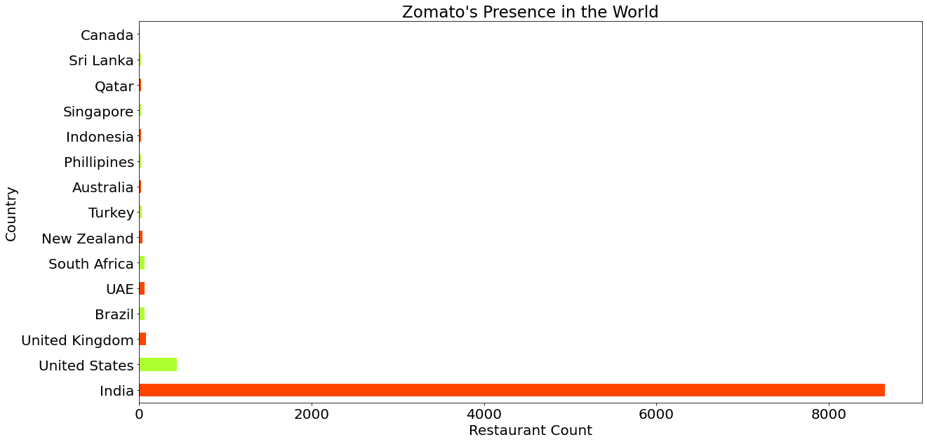
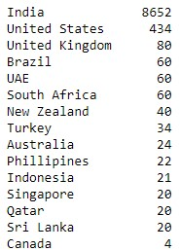
Descriptive Analysis: Zomato's Presence in the World with Restaurant Count
Spread across 15 Countries, It is clearly visible from the bar chart that Zomato is based in India, as India accounts for 8652 of the total 9491 restaurants listed on Zomato worldwide.
The United States is second, with only 434 of the total number of restaurants.
© All rights reserved by Fireblaze Technologies Pvt. Ltd.

Slide 5
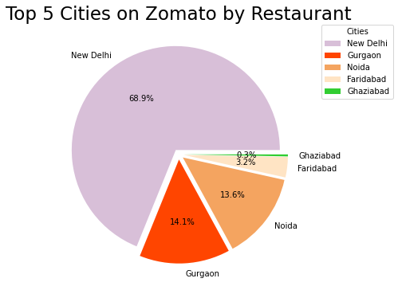
Descriptive Analysis: Top 5 Cities on Zomato by Restaurant
The data is skewed majorly towards the following Indian cities namely New Delhi, Gurgaon and Noida.
Minimal data is available for other cities.
Since I am from Nagpur, in the later part of the presentation my focus would be on Nagpur City.
© All rights reserved by Fireblaze Technologies Pvt. Ltd.

Slide 6
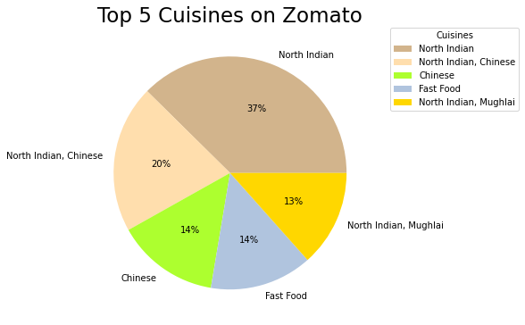
Descriptive Analysis: Top 5 Cuisines on Zomato
.These are the Top Cuisines served by the restaurants under Zomato. Which apparently are accounted from Indian restaurants.
© All rights reserved by Fireblaze Technologies Pvt. Ltd.

Slide 7
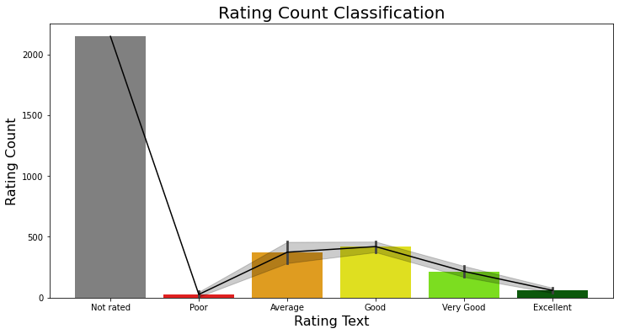
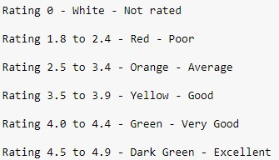
Descriptive Analysis: Rating Count Classification
Observation: Not rated count is very high comparatively.
Clearly, for all restaurants, Average (Orange) & Good (Yellow) are the most common ratings.
Major restaurants have average ratings between 2.5 to 3.9
Fewer restaurants have ratings less than 2.5
Very few restaurants have ratings greater than 4.4
© All rights reserved by Fireblaze Technologies Pvt. Ltd.

Slide 8
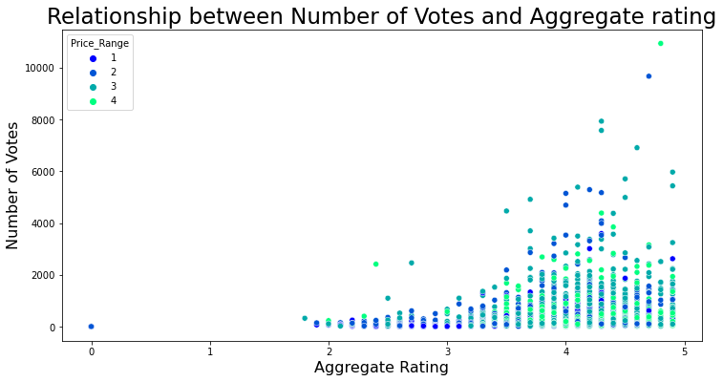
Descriptive Analysis: Aggregate Rating vs Number of Votes
The Scatter plot shows the relationship between the Number of Votes and Aggregate Rating.
We see that the maximum volume of ratings lie between 3.5 to 4.8, for the maximum votes received in the range of 0-2000.
© All rights reserved by Fireblaze Technologies Pvt. Ltd.

Slide 9
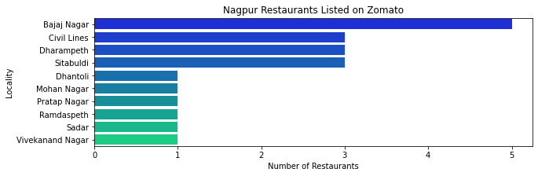
Descriptive Analysis: Restaurants in Nagpur as per Locality
The Bar Chart displays Locality-wise listed Restaurants on Zomato for Nagpur City.
Bajaj Nagar seems to have the highest no of restaurants registered with Zomato in Nagpur.
© All rights reserved by Fireblaze Technologies Pvt. Ltd.

Slide 10
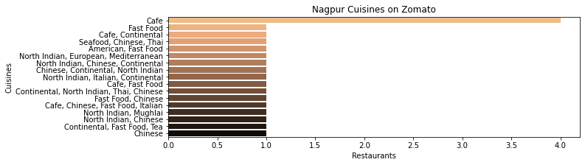
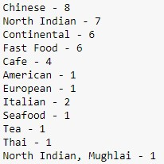
Descriptive Analysis: Cuisines in Nagpur
Graph shows Types of Cuisines offered by all the listed restaurants in Nagpur City.
In Nagpur, Chinese is the most common cuisine served followed by North Indian and Continental.
© All rights reserved by Fireblaze Technologies Pvt. Ltd.

Slide 11

Conclusion
Majority of the restaurants in the analysis are un-rated.
This data is biased as we have a maximum number of restaurants from India. Thus, the dataset is skewed towards India and doesn't represent the complete data of restaurants worldwide.
Restaurants rating is categorized under:
Not Rated
Average
Good
Very Good
Excellent
In Nagpur, Bajaj Nagar has the maximum number of restaurants listed with Zomato.
The top cuisines are:
North Indian
Chinese
Mughlai
Fastfood
© All rights reserved by Fireblaze Technologies Pvt. Ltd.

Slide 12

Future Scope
India represents nearly 90% of the total data available in the dataset.
The data should have contained more variables which would have resulted in a clearer picture regarding the restaurant earnings as per available cuisines and overall market domination by restaurant category.
© All rights reserved by Fireblaze Technologies Pvt. Ltd.

